Slide 1
What do you know about Mariusz Pudzianowski?
Co wiesz o Mariuszu Pudzianowskim?

Slide 2
1. What nationality is Mariusz Pudzianowski?
-Polish
-German
-Russian

Slide 3
Polish

Slide 4
2. How old is he?
-40
-32
-36

Slide 5
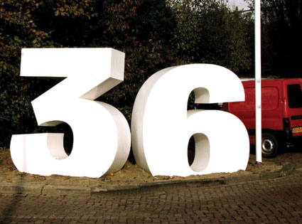

Slide 6
3. What is his favourite sport?
-tennis
-body building
-golf

Slide 7
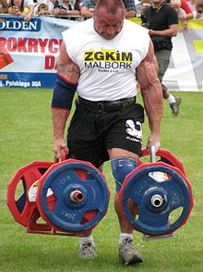
Body building

Slide 8
4.What does he do?
He is:
-a doctor
-a teacher
-a strongmam

Slide 9
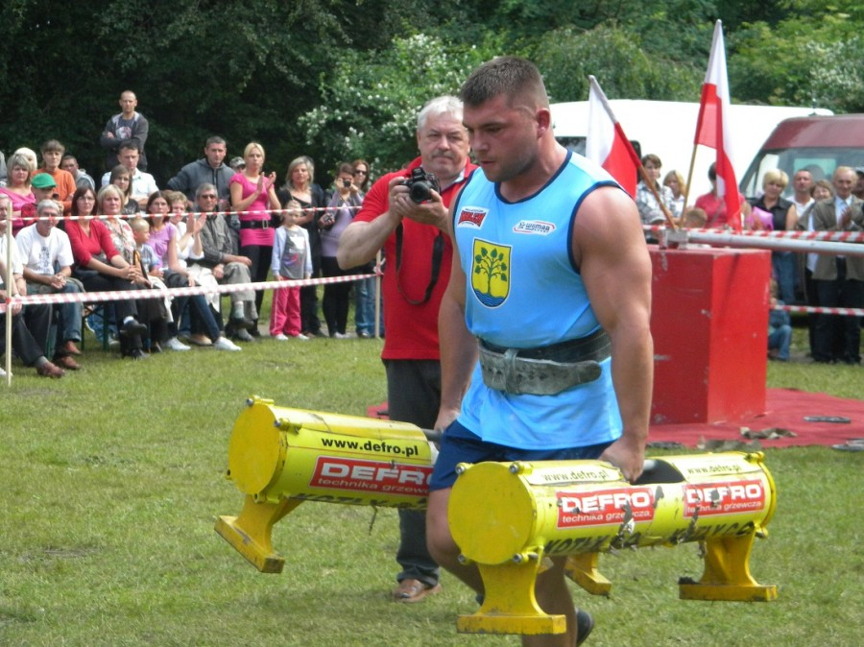
strongman

Slide 10
5. Where is he from?
Biała Rawska
Bielsko-Biała
Radom

Slide 12
6. What is his nickname?
-Godzilla
-Dominator
-Puzon

Slide 13
Dominator

Slide 14
7.How tall is he?
192
177
186

Slide 15
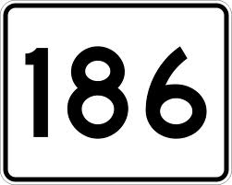

Slide 16
8. What can he do?
Dance
Speak Chinese
Play the guitar

Slide 17
Dance

Slide 18
9. What film does he act?
-Pierwsza Miłość
-Hotel 52
- Niania

Slide 19
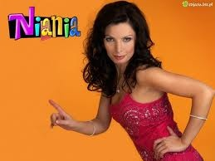

Slide 20
10. Does he have any brothers or sisters?
brother Krystian
sister Anna
brother Krystian and sister Anna

Slide 21
brother Krystian

Slide 22
THE END

